Slide 1


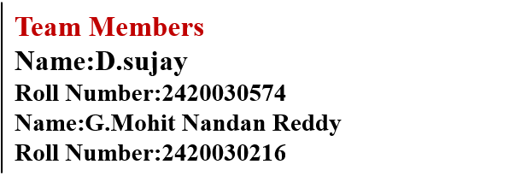
AI-Powered Student Result Processing and Academic Performance Analysis System
Project Title
SOA Project Review-2
Date 22-9-26
Date
SOA Project Review-1
1

Slide 2
Project Design
The Student Result Management System is designed as a Java-based desktop application for managing student details and examination results. The system provides separate functionalities for administrators and students.
The project uses Java Swing and AWT for designing the graphical user interface and MySQL for storing student and result information. JDBC (Java Database Connectivity) is used to connect the Java application with the MySQL database.
Main components of the design
Administrator Module
Admin Login
Add New Student
Add Student Result
View All Registered Students
View All Student Results
Student Module
Student Login
View Result

Slide 3
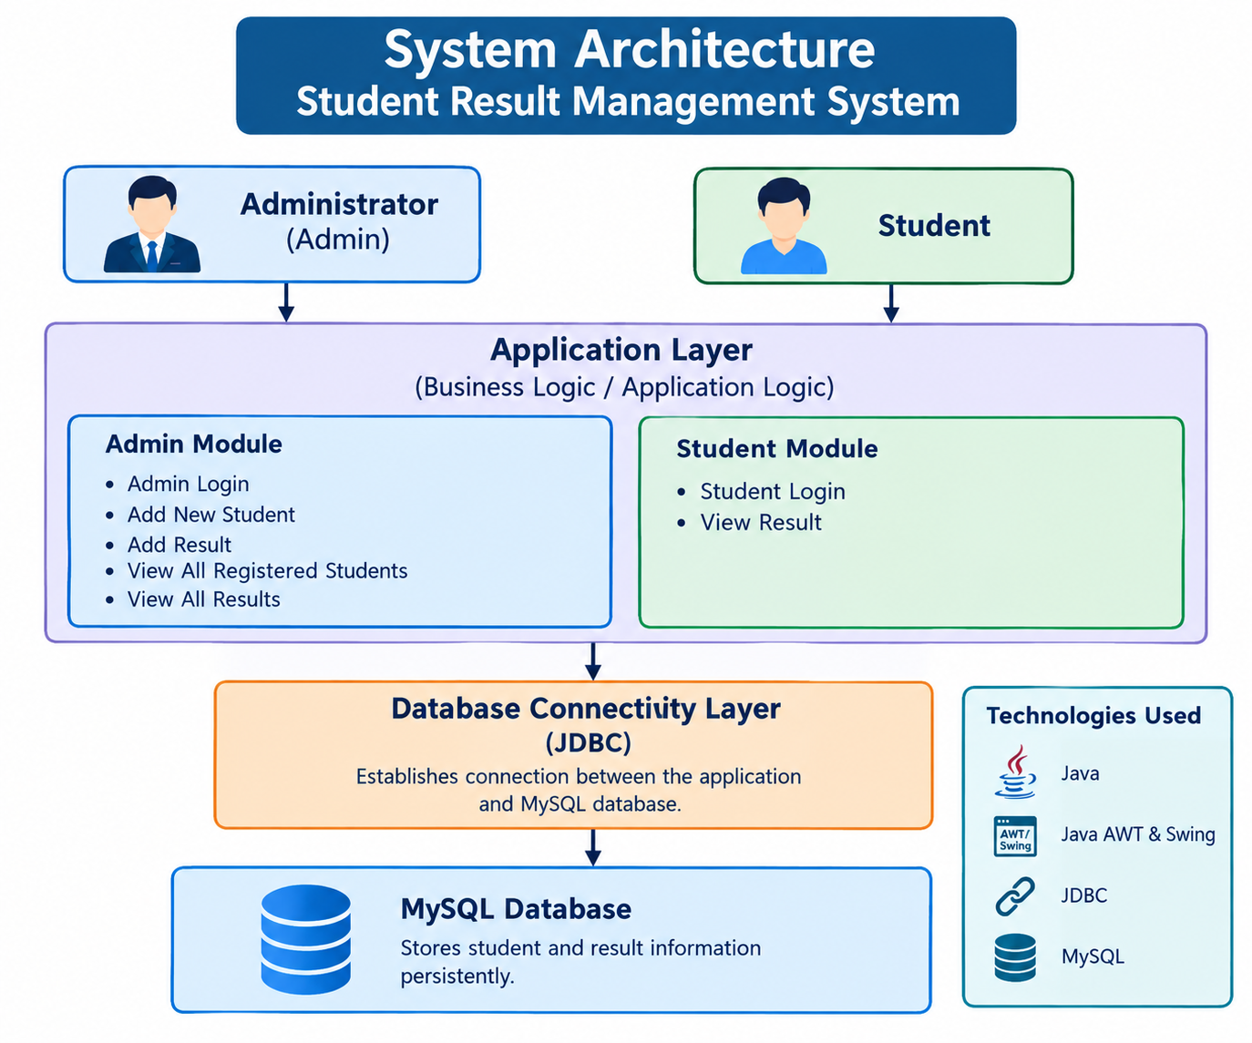

Slide 4
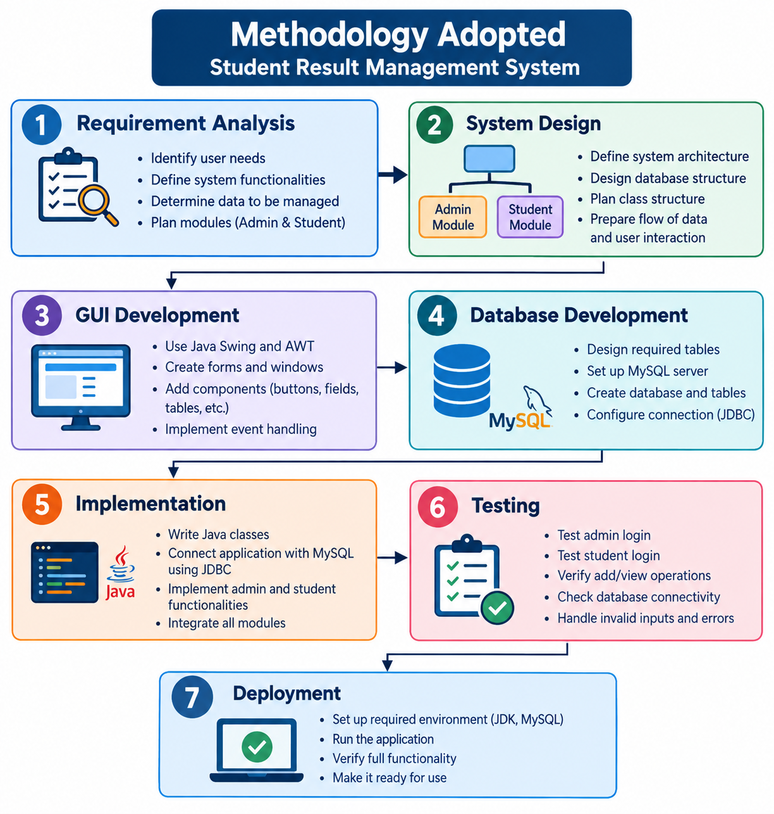

Slide 5
Technical Implementation
The Student Result Management System is implemented as a Java-based desktop application. Java Swing and AWT are used to develop the graphical user interface, including login forms, input forms, buttons, tables, and result-display screens.
The system uses Java classes and object-oriented programming concepts to implement the application logic. Event handling is used to respond to user actions such as button clicks and login operations.
MySQL is used as the backend database to store student details and examination results. JDBC (Java Database Connectivity) provides communication between the Java application and the MySQL database. SQL operations are used to insert and retrieve student and result information.
The system is divided into Admin and Student modules. The Admin can manage student and result information, while students can log in and view their results. This integration of Java, Swing/AWT, JDBC, SQL, and MySQL provides the technical foundation of the project.

Slide 6
Conclusion
The Student Result Management System successfully provides a computerized solution for managing student information and examination results. The system uses Java, Swing/AWT, JDBC, and MySQL to provide an easy-to-use interface, database connectivity, and efficient data management. The separate Admin and Student modules simplify the process of entering, managing, and viewing results.
Overall, the project demonstrates the practical application of Java programming, GUI development, database management, SQL, and JDBC connectivity. It reduces manual work, improves accessibility of student records, and provides a foundation that can be further enhanced into a web or mobile-based result management system.

Slide 7
THANK YOU

